Slide 1
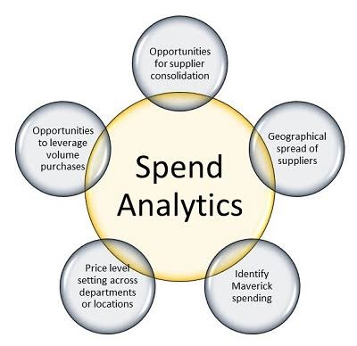
Spend Analytics
ABC Ltd.

Slide 2
ABC Ltd & Subsidiaries
worlds largest manufacturer of bathing soaps
HQ located in Milwaukee,WI,USA
10 subsidiaries world wide
USA
Neveda
Texas
Florida
Europe
Romania
France
Sweden
Asia-Paciﬁc
Australia
Indonesia
China
Africa

Slide 3
Soap Brands
Soap Brands
Wild Rancher(Men)
Tiger(Kids)
Alexa(Female)

Slide 4
Raw Material Primarily Consists
Potassium Hydroxide
Common for all Soaps
Oils
Palm for Wild Rancher
Olive for Alexa
Abrasives
Fragrances and Perfumes
Coconut for Tiger
Silica
Marble Pumice
Talc

Slide 5
Various costs elements
Raw Material
Production Mostly WIP costs and consumables.
Packaging
Logistics Shipping from Factory to Distribution Centers and DCs to Distributors.
Marketing and Sales - General Costs, Events, Campaigns etc.
Engineering Maintenance and Utilities.
Corporate Includes Corporate events, R&D and HR costs inclusive of Salaries

Slide 6
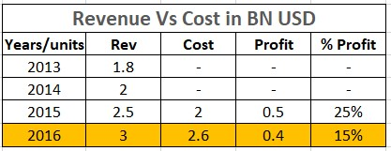
Problem Statement
At the end of Dec 2016, the growth rates & the margins have been less than satisfying .Profit is going down due to increase in cost.
Profit

Slide 7
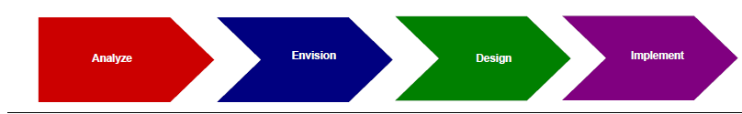
Approach
Assess Business Drivers and strategic direction
Complete a Diagnostic and case for change
Develop and evaluate high-level organization options
Create detailed level impact assessments
Detailed Design Document.
Recommended Changes.
Amended case for Change
High Level Implementation Plan.
Implemented Design
Operate Performance Plan
Capabilities Development Plans
Individual Development Plan

Slide 8
Major Cost Elements for Analysis
Raw Materials
Packaging
Indirect and direct procurement
Sub Cost Elements
Production - Mostly WIP costs and consumable
Logistics Shipping from Factory to Distribution Centers and DCs to Distributors.
Engineering - Maintenance and Utilities.
Corporate - Includes Corporate events, R&D and HR costs

Slide 9
Revenues in Billion USD
APAC and AFRICA have no increase in revenue for last four years

Slide 10
Proportion of revenues generated by different brands
Revenues is generated mostly by wild Rancher and Alexa brands i.e. 41% & 42 % respectively.
Tiger brand contribution is only 17%.

Slide 11
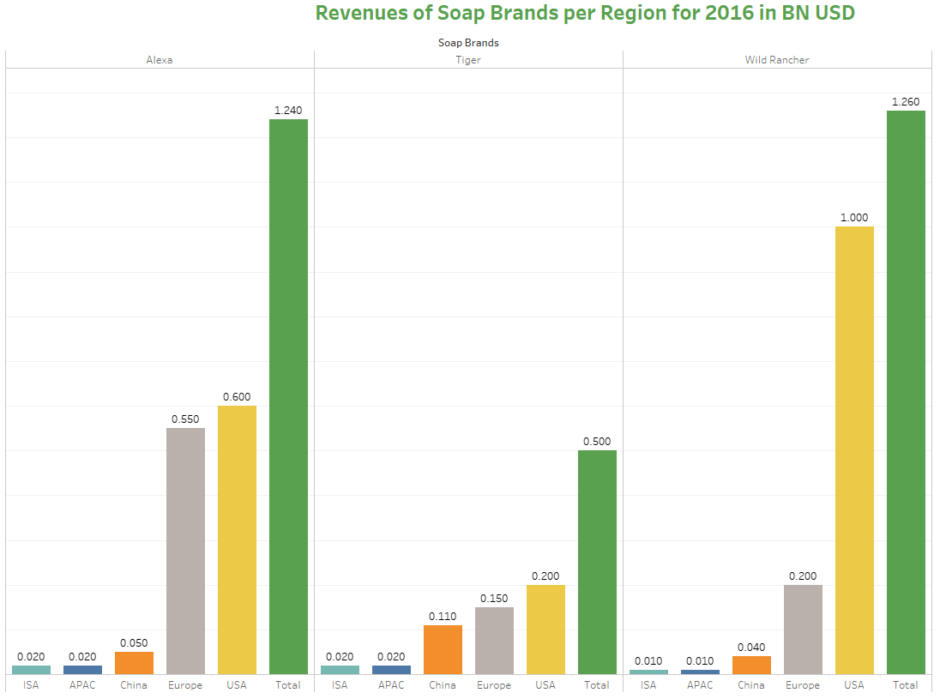
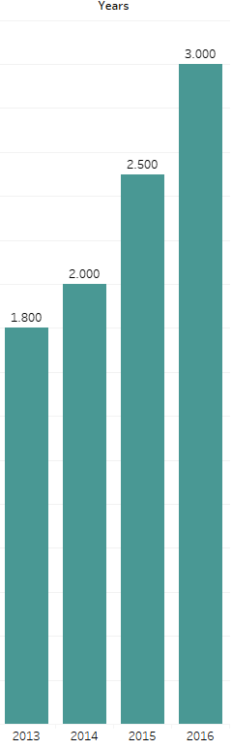
Revenue of ABC Ltd
Overall Revenues are increasing.
For Alexa brand this growth is exponential.

Slide 12
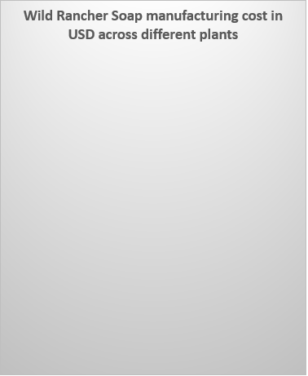
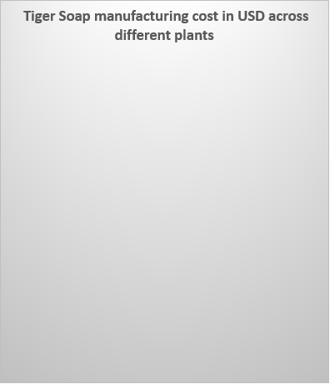
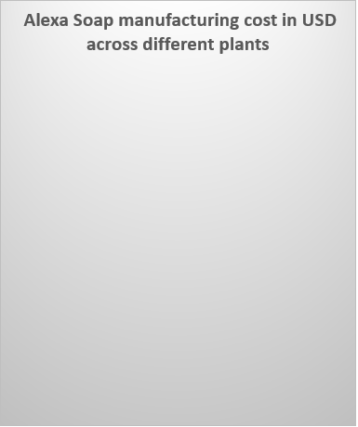
Soap Production Cost Region Wise
China has less material cost for wild rancher which is $ 1.11
China has less material cost for Alexa which is $1.23
China has less material cost for Tiger which is $1.11

Slide 13
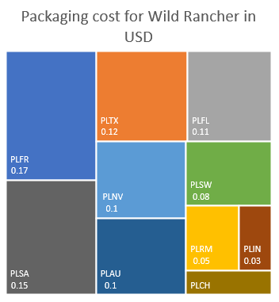
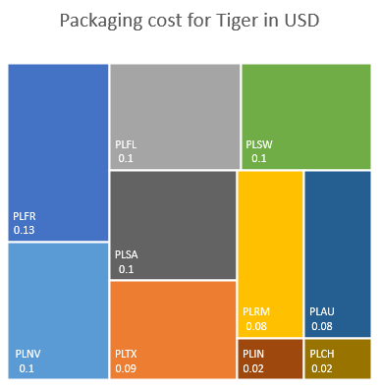
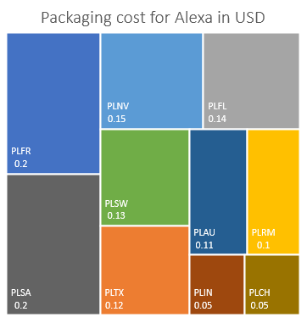
Packaging Cost/ Soap bar Region Wise
China and Indonesia has less but same Packaging cost which is 0.03 USD for Wild Rancher
China and Indonesia has less but same Packaging cost which is 0.05 USD for Alexa
China and Indonesia has less but same Packaging cost which is 0.02 USD for Tiger

Slide 14
Major Findings & Key Decisions
Increase the Revenue in APAC region and Africa.
To reduce manufacturing Cost and packaging cost shift many to one vendor
Identify low cost subsidiaries in 5 Region
Identify one low cost Region across all region
Profit should be increased
APAC region and AFRICA have no increase in revenue for last four years
Only 0.4 BN USD was the profit for the company in the year 2016
China is the region where these 3 brands of soap manufacturing cost is least.
China and Indonesia has least price for packaging materials

Slide 15
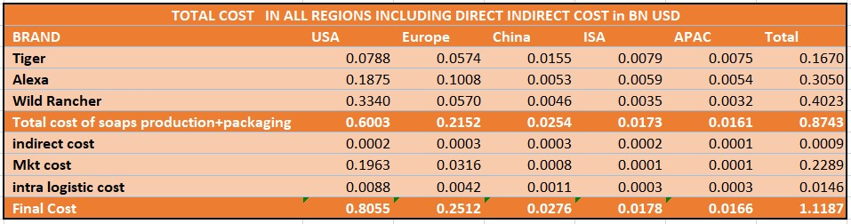
Scenario1-Base Line Model
Assumption-All plants are using their respective vendors for Raw materials and packaging materials.

Slide 16
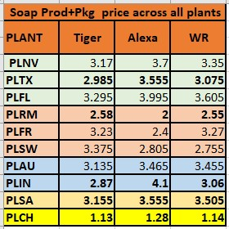
Scenario 2(lowest cost plants across the region are used)
Texas
Romania
Indonesia
South Africa
China
All price calculation are done in USD

Slide 17
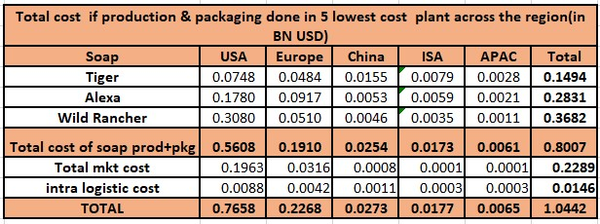
Scenario-2(only 5 plants are used for soap production & packaging)
Assumption-These 5 plants capacities are unlimited for soap production and packaging.

Slide 18
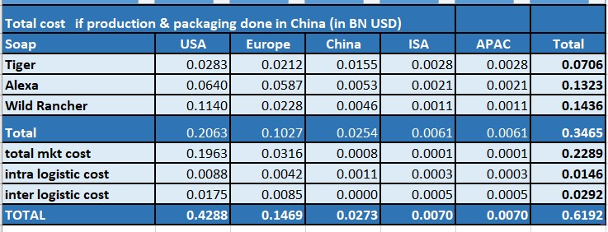
Scenario 3-China plant is used for soap production & packaging
Assumption-China plant capacity is unlimited for soap production and packaging.

Slide 19
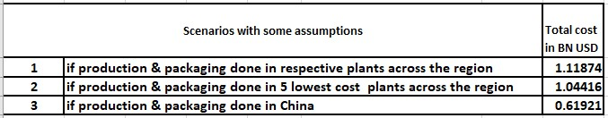
Conclusions
In these 3 scenarios if production and packaging both done in China plant ,cost is the least one as Raw material & packaging costs are very low as compare to other plants.

Slide 20
Recommendations(3-month roadmap)
1st -Increase the capacity of China plant
2nd -Procure all Raw materials & packaging materials from China & other lowest regions like
olive oil from Romania/ France, coconut & palm oil from Indonesia.
3rd -Use the China manpower to increase productivity

Slide 21
THANK YOU

